Slide 1
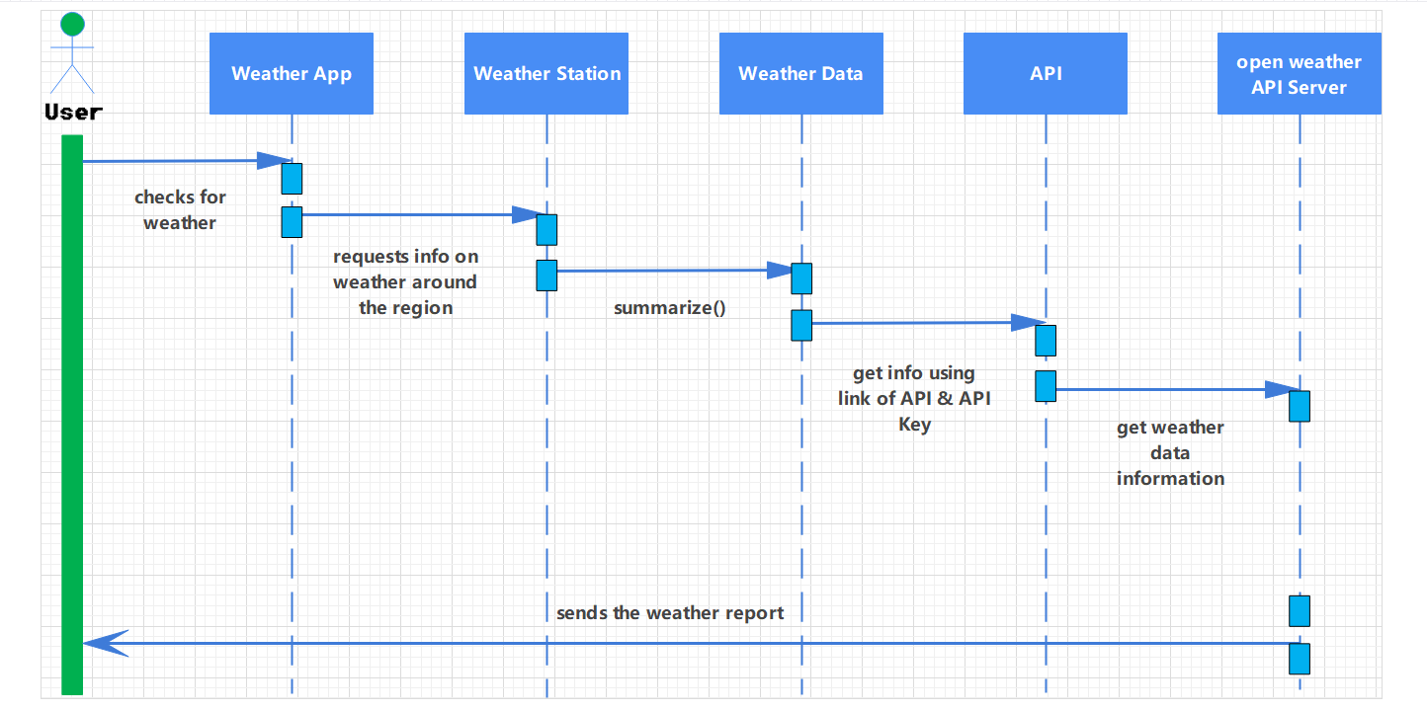
Sequence Diagram for weather forcasting application

